Slide 1

18CSC203J – COMPUTER ORGANIZATION AND ARCHITECTURE
UNIT-III
Course Outcome
CLR-3: Understand the concepts of Pipelining and basic processing units
CLO-3 : Analyze the detailed operation of Basic Processing units and the performance of Pipelining
‹#›

Slide 2
Topics Covered
Fundamental concepts of basic processing unit
Performing ALU operation
Execution of complete instruction, Branch instruction
Multiple bus organization
Hardwired control,
Generation of control signals
Micro-programmed control, Microinstruction
Micro-program Sequencing
Micro instruction with Next address field
Basic concepts of pipelining
Pipeline Performance
Pipeline Hazards-Data hazards, Methods to overcome Data hazards
Instruction Hazards
Hazards on conditional and Unconditional Branching
Control hazards
Influence of hazards on instruction sets
‹#›

Slide 3
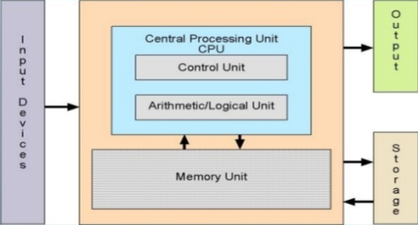
PROCESSING UNIT
FUNCTIONS OF CPU:
CPU carries out all forms of data processing tasks.
It saves information, intermediate results and instructions.
CPU monitors the functionality of all computer components.
COMPONENTS OF CPU:
Register: Stores data and result and speeds up the operation
Control unit: This unit monitors all computing processes but does not execute actual data processing.
Arithmetic Logic Unit (ALU): This does all the calculations and makes the decisions.
‹#›

Slide 4
FUNDAMENTAL CONCEPTS OF BASIC PROCESSING UNIT
Processor fetches one instruction at a time and perform the specified operation.
Instructions are fetched from successive memory locations except for branch/ jump instruction.
The address of the next instruction to be executed is tracked by the Program Counter (PC) register.
Instruction Register (IR) contains instruction that is currently executed.
Instruction execution happens in three phases:
Fetch: Fetch the instruction from the specified memory
Decode: Determined the opcode and the operands
Execute: Run the instruction
‹#›

Slide 5
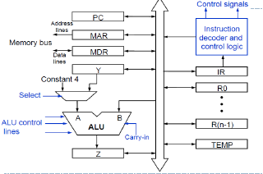
EXECUTING AN INSTRUCTION
Fetch the contents of memory location pointed by the PC. The contents of this memory location is loaded to the IR-Fetch phase
IR🡨 [[PC]]
Increment the PC by 4 (assume the word size as 4 )
PC🡨[PC]+4
Carry out the actions specified by the instruction in the IR-Execution phase
MDR: Two inputs and two outputs since data can be loaded from memory or processor bus.
MAR: Input line is connected to internal bus and output line to external bus
Control lines: connected to instruction decoder and control logic block to issue control signals
R0-R(n-1): General Purpose registers whose numbers vary between processors.
TEMP, Y and Z: temporary registers used by the processor during instruction execution
The registers, the ALU, and the interconnecting bus are collectively referred to as the datapath.
Fig : Single bus organization of datapath
‹#›

Slide 6
Executing an Instruction
With few exceptions, an instruction can be executed by performing one or more of the following operations in some specified sequence:
Transfer a word of data from one processor register to another or to the ALU.
Perform an arithmetic or a logic operation and store the result in a processor register.
Fetch the contents of a given memory location and load them into a processor register.
Store a word of data from a processor register into a given memory location.

Slide 7
Register Transfers
Instruction execution involves a sequence of steps in which data are transferred from one register to another.
For each register, two control signals are used to place the contents of that register on the bus or to load the data on the bus into the register.
The input and output of register Ri are connected to the bus
via switches controlled by the signals Ri_{in} and
^{Ri}out
respectively.
When Ri_{in} is set to 1, the data on the bus are loaded into Ri.
Similarly, when Ri_{out} is set to 1, the contents of register Ri are placed on the bus.
While Ri_{out} is equal to 0, the bus can be used for transferring data from other registers.

Slide 8




Register Transfers
Internal processor
bus
Ri_{in}
Ri
^{Ri}out
^{Y}in
Y
Constant 4
Select
MUX
A
B
ALU
^{Z}in
Z
^{Z}out
Figure 7.2. Input and output gating for the registers in Figure 7.1.

Slide 9
Performing an Arithmetic or Logic Operation
The ALU is a combinational circuit that has no internal storage.
ALU gets the two operands from MUX and bus. The result is temporarily stored in register Z.
What is the sequence of operations to add the contents of register R1 to those of R2 and store the result in R3?
❑
R1_{out}, Y_{in}
R2_{out}, SelectY, Add, Z_{in}
Z_{out}, R3_{in}

Slide 10
Performing an Arithmetic or Logic Operation
In step 1, the output of register R1 and the input of register Y are enabled, causing the contents of R1 to be transferred over the bus to Y.
In step 2, the multiplexer's Select signal is set to SelectY, causing the multiplexer to gate the contents of register Y to input A of the ALU.
At the same time, the contents of register R2 are gated onto the bus and, hence, to input B.

Slide 11
Performing an Arithmetic or Logic Operation
The function performed by the ALU depends on the signals applied to its control lines.
In this case, the Add line is set to 1, causing the output of the ALU to be the sum of the two numbers at inputs A and B.
This sum is loaded into register Z because its input control signal is activated.
In step 3, the contents of register Z are transferred to the destination register, R3.
This last transfer cannot be carried out during step 2, because only one register output can be connected to the bus during any clock cycle.

Slide 12
Fetching a Word from Memory
To fetch a word of information from memory, the processor has to specify the address of the memory location where this information is stored and request a Read operation.
This applies whether the information to be fetched represents an instruction in a program or an operand specified by an instruction.
The processor transfers the required address to the MAR, whose output is connected to the address lines of the memory bus.

Slide 13
Fetching a Word from Memory
At the same time, the processor uses the control lines of the memory bus to indicate that a Read operation is needed.
When the requested data are received from the memory they are stored in register MDR, from where they can be transferred to other registers in the processor.
The connections for register MDR are illustrated in Figure 7.4 on next slide.
It has four control signals: MDR_{in} and MDR_{out} control the connection to the internal bus, and MDR_{in E} and MDR_{out E} control the connection to the external bus.

Slide 14
Fetching a Word from Memory
Address into MAR; issue Read operation; data into MDR.
Memory-bus data lines
Internal process bus
^{MDR}outE
MDR_{out}
MDR
MDR_{inE}
MDR_{in}
Figure 7.4. Connection and control signals for register MDR.
Figure 7.4. Connection and control signals fogisterr re MDR.

Slide 15
Fetching a Word from Memory
As an example of a read operation, consider the instruction Move (R1), R2. The actions needed to execute this instruction are:
MAR ← [R1]
Start a Read operation on the memory bus
Wait for the MFC response from the memory
Load MDR from the memory bus
R2 ← [MDR]
These actions may be carried out as separate steps, but some can be combined into a single step.
Each action can be completed in one clock cycle, except action 3 which requires one or more clock cycles, depending on the speed of the addressed device.

Slide 16
Fetching a Word from Memory
A Read control signal is activated at the same time MAR is loaded.
The data received from the memory are loaded into MDR at the end of the clock cycle in which the MFC signal is received.
In the next clock cycle, MDR_{out} is activated to transfer the data to register R2.
This means that the memory read operation requires three steps, which can be described by the signals being activated as follows:
R1_{out,}MAR_{in}, Read
MDR_{in E,} WMFC
MDR_{out} R2_{in}

Slide 17
Storing a Word in Memory
The desired address is loaded into MAR.
Then, the data to be written are loaded into MDR, and a Write command is issued.
Hence, executing the instruction Move R2,(Rl) requires the following sequence:
R1_{out,}MAR_{in}
R2_{out,} MDR_{in,} Write
MDR_{out E,} WMFC
The processor remains in step 3 until the memory operation is completed and an MFC response is received.

Slide 18
Execution of a Complete Instruction
Consider the instruction
Add (R3), R1
Executing this instruction requires the following actions:
Fetch the instruction
Fetch the first operand (the contents of the memory location pointed to by R3)
Perform the addition
Load the result into R1

Slide 19

Execution of a Complete Instruction
Internal processor bus
Add (R3), R1
Control signals
PC
Instruction decoder and control logic
Step
Action
Address lines
MAR
1
2
3
4
5
6
7
PC_{out} , MAR _{in} , Read, Select4,Add, Z_{in} Z_{out} , PC_{in} , Y_{in} , WMF C
MDR _{out} , IR _{in}
R3_{out} , MAR _{in} , Read R1_{out} , Y_{in} , WMF C
Memory bus
Data lines
MDR
IR
Y
Constant 4
R0
MDR _{out} , SelectY, Add, Z_{in} Z_{out} , R1_{in} , End
Select
MUX
Add
ALU
control lines
Sub
A B
R n - 1
ALU
XOR
Carry-in
Figure 7.6. Control sequencefor execution of the instruction Add (R3),R1.
TEMP
Z
Figure 7.1. Single-bus organization of the datapath inside a proc

Slide 20
Execution of a Complete Instruction
In step 1, the instruction fetch operation is initiated by loading the contents of the PC into the MAR and sending a Read request to the memory.
The Select signal is set to Select4, which causes the multiplexer MUX to select the constant 4. This value is added to the operand at input B, which is the contents of the PC, and the result is stored in register Z.
The updated value is moved from register Z back into the PC during step 2, while waiting for the memory to respond.
In step 3, the word fetched from the memory is loaded into the IR.
Steps 1 through 3 constitute the instruction fetch phase, which is the same for all instructions.

Slide 21
Execution of a Complete Instruction
The instruction decoding circuit interprets the contents of the IR at the beginning of step 4.
This enables the control circuitry to activate the control signals for steps 4 through 7, which constitute the execution phase.
The contents of register R3 are transferred to the MAR in step 4, and a memory read operation is initiated.
Then the contents of R1 are transferred to register Y in step 5, to prepare for the addition operation.
When the Read operation is completed, the memory operand is available in register MDR, and the addition operation is performed in step 6.

Slide 22
Execution of a Complete Instruction
The contents of MDR are gated to the bus, and thus also to the B input of the ALU, and register Y is selected as the second input to the ALU by choosing SelectY.
The sum is stored in register Z, then transferred to R1 in step 7.
The End signal causes a new instruction fetch cycle to begin by returning to step 1.
This discussion accounts for all control signals except Y_{in} in step 2.
There is no need to copy the updated contents of PC into register Y when executing the Add instruction.
But, in Branch instructions the updated value of the PC is needed to compute the Branch target address.

Slide 23
Execution of a Complete Instruction
To speed up the execution of Branch instructions, this value is copied into register Y in step 2.
Since step 2 is part of the fetch phase, the same action will be performed for all instructions. This does not cause any harm because register Y is not used for any other purpose at that time.

Slide 24
Execution of Branch Instructions
A branch instruction replaces the contents of PC with the branch target address, which is usually obtained by adding an offset X given in the branch instruction.
Step Action
1
2
3
4
5
PC_{out} , MAR _{in} , Read, Select4,Add, Z_{in} Z_{out}, PC_{in} , Y_{in}, WMF C
MDR_{out} , IR_{in}
Offset-field-of-IR_{out}, Add, Z_{in} Z_{out}, PC_{in} , End
Figure 7.7. Control sequence for an unconditional branch instruction.

Slide 25
Execution of Branch Instructions
Processing starts, as usual, with the fetch phase. This phase ends when the instruction is loaded into the IR in step 3.
The offset value is extracted from the IR by the instruction decoding circuit.
Since the value of the updated PC is already available in register Y, the offset X is gated onto the bus in step 4, and an addition operation is performed.
The result, which is the branch target address, is loaded into the PC in step 5.
The offset X is usually the difference between the branch target address and the address immediately following the branch instruction.

Slide 26
Execution of Conditional Branch Instructions
Conditional branch
In this case, we need to check the status of the condition codes before loading a new value into the PC.
For example, for a Branch-on negative (Branch<O) instruction, step 4 in Figure 7.7 is replaced with
Offset-field-of-IR_{out}, Add, Z_{in}, If N = 0 then End
Thus, if N = 0 the processor returns to step 1 immediately after step 4.
If N = 1, step 5 is performed to load a new value into the PC, thus performing the branch operation.

Slide 27
Execution of Conditional Branch Instructions
Step Action
1
2
3
4
5
PC_{out} , MAR _{in} , Read, Select4,Add, Z_{in} Z_{out}, PC_{in} , Y_{in}, WMF C
MDR_{out} , IR_{in}
^{Offset-field-of-IR}_{out}^{, Add, Z}_{in} If N = 0 then End Z_{out}, PC_{in} , End
Figure. Control sequence for an conditional branch instruction.

Slide 28

Multiple-Bus Organization
Till now, we have considered the simple single-bus structure of processing unit to illustrate the basic ideas.
Bus A
Bus B
Bus C
Incrementer
PC
Register file
The resulting control sequence to execute a instruction is quite long because only one data item can be transferred over the bus in a clock cycle.
Constant 4
MUX
A
ALU
R
B
Instruction decoder
To reduce the number of steps needed, most commercial processors provide multiple internal paths that enable several transfers to take place in parallel.
IR
MDR
MAR
Memory bus data lines
Address lines
Figure 7.8. Three-bus organization of the datapath.

Slide 29
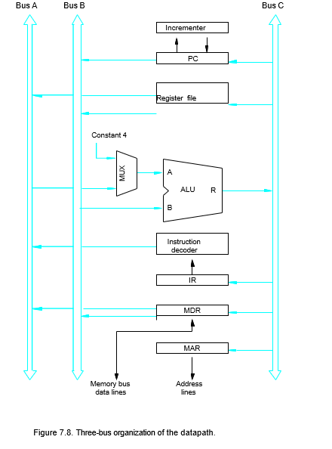
‹#›

Slide 30
Multiple-Bus Organization
All general-purpose registers are combined into a single block called the register file.
The register file in Figure 7.8 is said to have three ports.
There are two outputs, allowing the contents of two different registers to be accessed simultaneously and have their contents placed on buses A and B.
The third port allows the data on bus C to be loaded into a third register during the same clock cycle.
Buses A and B are used to transfer the source operands to the A and B inputs of the ALU, where an arithmetic or logic operation may be performed.
The result is transferred to the destination over bus C.

Slide 31
Multiple-Bus Organization
If needed, the ALU may simply pass one of its two input operands unmodified to bus C.
We will call the ALU control signals for such an operation R=A or R=B.
The three-bus arrangement obviates the need for registers Y and Z as required in single-bus structure processing unit.
A second feature in
Multiple-Bus
Organization is the
introduction of the Incrementer unit, which is used to increment the PC by 4.
Using the Incrementer eliminates the need to add 4 to the PC using the main ALU.
The source for the constant 4 at the ALU input multiplexer is still useful.

Slide 32
Multiple-Bus Organization
It can be used to increment other addresses, such as the memory addresses in LoadMultiple and StoreMultiple instructions.
Consider the three-operand instruction
Add R4,R5,R6
The control sequence for executing this instruction is given on next slide.

Slide 33
Multiple-Bus Organization
Add R4, R5, R6
Step Action
1
2
3
4
PC_{out}, WMFC
R=B, MAR _{in} , Read, IncPC
MDR_{outB}, R=B, IR _{in}
^{R4}outA^{, R5}outB,
SelectA, Add, R6_{in} , End
Figure 7.9. Control sequence for the instruction. Add R4,R5,R6, for the three-bus organization in Figure 7.8.

Slide 34
Multiple-Bus Organization
In step 1, the contents of the PC are passed through the ALU, using the R=B control signal, and loaded into the MAR to start a memory read operation.
At the same time the PC is incremented by 4.
In step 2, the processor waits for MFC and loads the data received into MDR, then transfers them to IR in step 3.
Finally, the execution phase of the instruction requires only one control step to complete, step 4.
By providing more paths for data transfer a significant reduction in the number of clock cycles needed to execute an instruction is achieved.

Slide 35
Hardwired Control
‹#›
Notes:
‹#›

Slide 36
Overview
To execute instructions, the processor must have some means of generating the control signals needed in the proper sequence.
Two categories: hardwired control and microprogrammed control
Hardwired system can operate at high speed; but with little flexibility.
‹#›
Notes:
‹#›

Slide 37
7 Steps:
‹#›
Notes:
‹#›

Slide 38
Control Unit Organization
Clock
CLK
Control step counter
External inputs
Decoder/ encoder
IR
Condition codes
Control signals
Figure 7.10. Control unit organization.

Slide 39
Detailed Block Description
Clock
CLK
Control step counter
Reset
Step decoder
T₁ T₂ T_{n}
Encoder
IR
Instruction decoder | INS₁
 | INS₂
External inputs
Condition codes
INS_{m}
Run
End
Control signals
Figure 7.11. Separation of the decoding and encoding functio

Slide 40
Hardwired Control
The step decoder provides a separate signal line for each step, or time slot, in the control sequence.
Similarly, the output of the instruction decoder consists of a separate line for each machine instruction.
For any instruction loaded in the IR, one of the output lines INS₁ through INS_{m} is set to 1, and all other lines are set to 0.
The input signals to the encoder block in Figure 7.11 are combined to generate the individual control signals Y_{in}, PC_{out}, Add, End, and so on.
An example of how the encoder generates the Z_{in} control signal for the processor organization in Figure 7.1 is given in Figure 7.12. on next slide

Slide 41
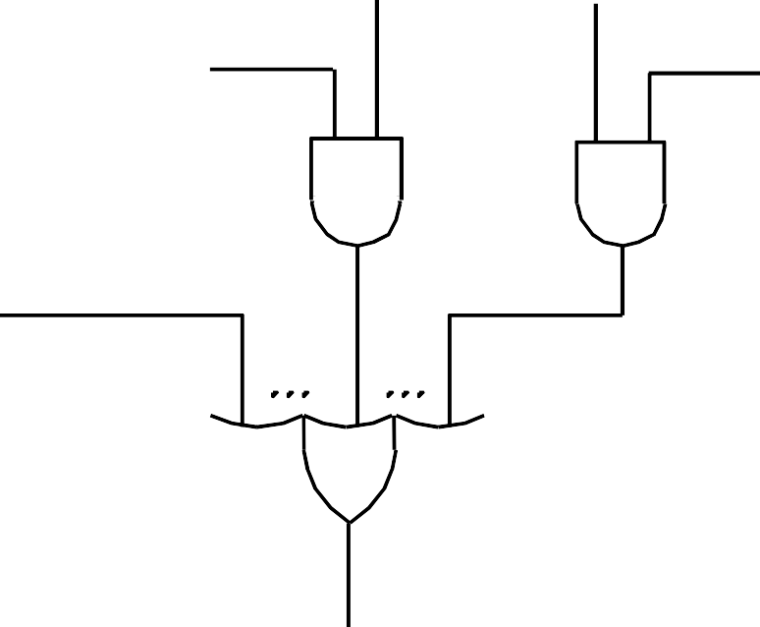
Generating Z_{in}
This circuit implements the logic function
Z_{in} = T₁ + T₆ • ADD + T₄ • BR + …
Branch
Add
This
signal is
asserted during
T₄
T₆
time slot T1 for all instructions,
during Add during
T6 for an
instruction,
T₁
T4 for an
unconditional branch instruction, and so on.
Figure 7.12. Generation of the Z_{in} control signal for the processor in Figure 7.1.

Slide 42





Generating End
End = T7 • ADD + T5 • BR + (T5 • N + T4 • N) • BRN +…
Branch<0
Add
N
Branch
N
T₇
T₅
T₄
T₅
End
Figure 7.13. Generation of the End control signal.

Slide 43

A Complete Processor
Instruction unit
Integer unit
Floating-point unit
Instruction cache
Data cache
Bus interface
Processor
System bus
Main memory
Input/ Output
Figure 7.14. Block diagram of a complete proces.sor

Slide 44
A Complete Processor
This structure has an instruction unit that fetches instructions from an instruction cache or from the main memory when the desired instructions are not already in the cache.
It has separate processing units to deal with integer data and floating-point data.
A data cache is inserted between these units and the main memory.
Using separate caches for instructions and data is common practice in many processors today. Other processors use a single cache that stores both instructions and data.
The processor is connected to the system bus and, hence, to the rest of the computer, by means of a bus interface.

Slide 45
Microprogrammed Control

Slide 46
Microprogrammed Control
A control unit whose binary control variables are stored in memory is called a micro programmed control unit.
‹#›

Slide 47
Microprogrammed Control

Slide 48
Microprogrammed Control Unit
Control signals
Group of bits used to select paths in multiplexers, decoders, arithmetic logic units
Control variables
Binary variables specify microoperations
Certain microoperations initiated while others idle
Control word
is a word whose individual bits represent the various control signals
‹#›

Slide 49
Microprogrammed Control Unit
Control memory
The microroutines for all instructions in the instruction set of a computer are stored in a special memory called the control store/control memory
Microinstructions
A sequence of CWs corresponding to the control sequence of a machine instruction constitutes the microroutine for that instruction, and the individual control words in this microroutine are referred to as microinstructions
Microprogram
Sequence of microinstructions
‹#›

Slide 50
Control Unit Implementation
Hardwired
Memory
Instruction code
Sequence Counter
Combinational
.
.
Control
signals
Logic Circuits
Microprogrammed
CAR: Control Address Register
CDR: Control Data Register
Memory
Instruction code
Next Address
Control
Memory
Decoding
Circuit
.
.
Control
signals
Generator
(sequencer)
CAR
CDR
‹#›

Slide 51
Control Memory
Read-only memory (ROM)
Content of word in ROM at given address specifies microinstruction
Each computer instruction initiates series of microinstructions (microprogram) in control memory
These microinstructions generate microoperations to
Fetch instruction from main memory
Evaluate effective address
Execute operation specified by instruction
Return control to fetch phase for next instruction
Control memory (ROM)
Address
Control word (microinstruction)
‹#›

Slide 52
Microprogrammed Control Organization
External
input
Next Address
Control
Memory
(ROM)
Generator
(sequencer)
CAR
CDR
Control
word
Control memory
Contains microprograms (set of microinstructions)
Microinstruction contains
Bits initiate microoperations
Bits determine address of next microinstruction
Control address register (CAR)
Specifies address of next microinstruction
‹#›

Slide 53
Microprogrammed Control Organization
Next address generator (microprogram sequencer)
Determines address sequence for control memory
Microprogram sequencer functions
Increment CAR by one
Transfer external address into CAR
Load initial address into CAR to start control operations
‹#›

Slide 54
Microprogrammed Control Organization
Control data register (CDR)- or pipeline register
Holds microinstruction read from control memory
Allows execution of microoperations specified by control word simultaneously with generation of next microinstruction
Control unit can operate without CDR
External
input
Next Address
Control
Memory
(ROM)
Generator
(sequencer)
CAR
Control
word
‹#›

Slide 55
Microinstruction Sequencing:
A micro-program control unit can be viewed as consisting of two parts:
The control memory that stores the microinstructions.
Sequencing circuit that controls the generation of the next address.
‹#›

Slide 56
Microinstruction Sequencing:
A micro-program sequencer attached to a control memory inputs certain bits of the microinstruction, from which it determines the next address for control memory. A typical sequencer provides the following address-sequencing capabilities:
Increment the present address for control memory.
Branches to an address as specified by the address field of the micro instruction.
Branches to a given address if a specified status bit is equal to 1.
Transfer control to a new address as specified by an external source (Instruction Register).
Has a facility for subroutine calls and returns.
‹#›

Slide 57
Microinstruction Sequencing:
Depending on the current microinstruction condition flags, and the contents of the instruction register, a control memory address must be generated for the next micro instruction.
There are three general techniques based on the format of the address information in the microinstruction:
Two Address Field.
Single Address Field.
Variable Format
‹#›

Slide 58
Two address field
The simplest approach is to provide two address field in each microinstruction and multiplexer is provided to select:
Address from the second address field.
Starting address based on the OPcode field in the current instruction.
The address selection signals are provided by a branch logic module whose input consists of control unit flags plus bits from the control partition of the micro instruction.
‹#›

Slide 59
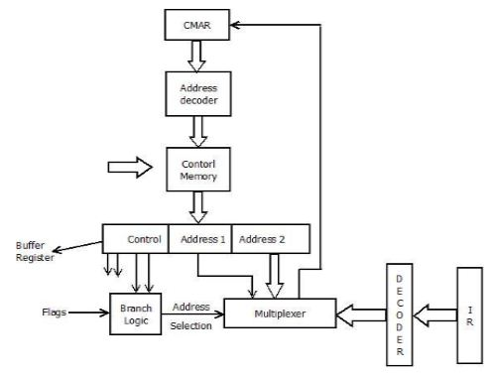
Two address field
‹#›

Slide 60
Single address field
Two-address approach is simple but it requires more bits in the microinstruction. With a simpler approach, we can have a single address field in the micro instruction with the following options for the next address.
Address Field.
Based on OPcode in instruction register.
Next Sequential Address.
enter image description here
The address selection signals determine which option is selected. This approach reduces the number of address field to one. In most cases (in case of sequential execution) the address field will not be used. Thus the microinstruction encoding does not efficiently utilize the entire microinstruction.
‹#›

Slide 61
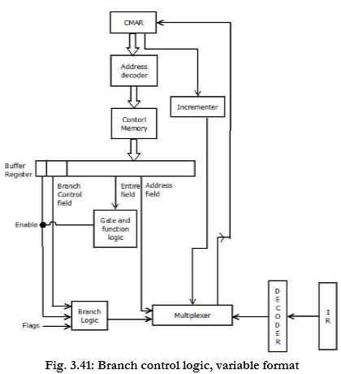
Single address field
‹#›

Slide 62
Variable Format
In this approach, there are two entirely different microinstruction formats. One bit designates which format is being used. In this first format, the remaining bits are used to activate control signals.
In the second format, some bits drive the branch logic module, and the remaining bits provide the address. With the first format, the next address is either the next sequential address or an address derived from the instruction register. With the second format, either a conditional or unconditional branch is specified.
‹#›

Slide 63
Variable Format
‹#›

Slide 64
Address Sequencing
Address sequencing capabilities required in control unit
Incrementing CAR
Unconditional or conditional branch, depending on status bit conditions
Mapping from bits of instruction to address for control memory
Facility for subroutine call and return
‹#›

Slide 65
Address Sequencing
Instruction code
Mapping
logic
Status
bits
Branch
MUX
Multiplexers
logic
select
Subroutine
Register
(SBR)
Control Address Register
(CAR)
Incrementer
Control memory (ROM)
select a status
bit
Branch address
Microoperations
‹#›

Slide 66
Microprogram Example
MUX
Computer
Configuration
10
0
AR
Address
Memory
10
0
2048 x 16
PC
MUX
6
0
6
0
15
0
DR
SBR
CAR
Control memory
Arithmetic
logic and
shift unit
128 x 20
Control unit
15
0
AC
‹#›

Slide 67
Microprogram Example
Computer instruction format
15
14
11
10
0
I
Opcode
Address
Four computer instructions
Symbol OP-code Description
EA is the effective address
ADD 0000 AC ← AC + M[EA]
BRANCH 0001 if (AC < 0) then (PC ← EA)
STORE 0010 M[EA] ← AC
EXCHANGE 0011 AC ← M[EA], M[EA] ← AC
Microinstruction Format
3
3
3
2
2
7
F1
F2
F3
CD
BR
AD
F1, F2, F3: Microoperation fields
CD: Condition for branching
BR: Branch field
AD: Address field
‹#›

Slide 68
Microinstruction Fields
F1 Microoperation Symbol
000 None NOP
001 AC ← AC + DR ADD
010 AC ← 0 CLRAC
011 AC ← AC + 1 INCAC
100 AC ← DR DRTAC
101 AR ← DR(0-10) DRTAR
110 AR ← PC PCTAR
111 M[AR] ← DR WRITE
F2 Microoperation Symbol
000 None NOP
001 AC ← AC - DR SUB
010 AC ← AC ∨ DR OR
011 AC ← AC ∧ DR AND
100 DR ← M[AR] READ
101 DR ← AC ACTDR
110 DR ← DR + 1 INCDR
111 DR(0-10) ← PC PCTDR
F3 Microoperation Symbol
000 None NOP
001 AC ← AC ⊕ DR XOR
010 AC ← AC’ COM
011 AC ← shl AC SHL
100 AC ← shr AC SHR
101 PC ← PC + 1 INCPC
110 PC ← AR ARTPC
111 Reserved
‹#›

Slide 69
Microinstruction Fields
CD Condition Symbol Comments
00 Always = 1 U Unconditional branch
01 DR(15) I Indirect address bit
10 AC(15) S Sign bit of AC
11 AC = 0 Z Zero value in AC
BR Symbol Function
00 JMP CAR ← AD if condition = 1
CAR ← CAR + 1 if condition = 0
01 CALL CAR ← AD, SBR ← CAR + 1 if condition = 1
CAR ← CAR + 1 if condition = 0
10 RET CAR ← SBR (Return from subroutine)
11 MAP CAR(2-5) ← DR(11-14), CAR(0,1,6) ← 0
‹#›

Slide 70
Symbolic Microinstruction
Sample Format Label: Micro-ops CD BR AD
Label may be empty or may specify symbolic address
terminated with colon
Micro-ops consists of 1, 2, or 3 symbols separated by commas
CD one of {U, I, S, Z}
U: Unconditional Branch
I: Indirect address bit
S: Sign of AC
Z: Zero value in AC
BR one of {JMP, CALL, RET, MAP}
AD one of {Symbolic address, NEXT, empty}
‹#›

Slide 71
Fetch Routine
Fetch routine
- Read instruction from memory
- Decode instruction and update PC
Microinstructions for fetch routine:
AR ← PC
DR ← M[AR], PC ← PC + 1
AR ← DR(0-10), CAR(2-5) ← DR(11-14), CAR(0,1,6) ← 0
Symbolic microprogram for fetch routine:
FETCH:
ORG 64
PCTAR U JMP NEXT
READ, INCPC U JMP NEXT
DRTAR U MAP
Binary microporgram for fetch routine:
Binary
address F1 F2 F3 CD BR AD
1000000 110 000 000 00 00 1000001
1000001 000 100 101 00 00 1000010
1000010 101 000 000 00 11 0000000
‹#›

Slide 72
Symbolic Microprogram
Control memory: 128 20-bit words
First 64 words: Routines for 16 machine instructions
Last 64 words: Used for other purpose (e.g., fetch routine and other subroutines)
Mapping: OP-code XXXX into 0XXXX00, first address for 16 routines are
0(0 0000 00), 4(0 0001 00), 8, 12, 16, 20, ..., 60
Partial Symbolic Microprogram
Label Microops CD BR AD
ADD:
BRANCH:
OVER:
STORE:
EXCHANGE:
FETCH:
INDRCT:
ORG 0
NOP
READ
ADD
ORG 4
NOP
NOP
NOP
ARTPC
ORG 8
NOP
ACTDR
WRITE
ORG 12
NOP
READ
ACTDR, DRTAC
WRITE
ORG 64
PCTAR
READ, INCPC
DRTAR
READ
DRTAR
I
U
U
S
U
I
U
I
U
U
I
U
U
U
U
U
U
U
U
CALL
JMP
JMP
JMP
JMP
CALL
JMP
CALL
JMP
JMP
CALL
JMP
JMP
JMP
JMP
JMP
MAP
JMP
RET
INDRCT
NEXT
FETCH
OVER
FETCH
INDRCT
FETCH
INDRCT
NEXT
FETCH
INDRCT
NEXT
NEXT
FETCH
NEXT
NEXT
NEXT
‹#›

Slide 73
Binary Microprogram
Address Binary Microinstruction
Micro Routine Decimal Binary F1 F2 F3 CD BR AD
ADD 0 0000000 000 000 000 01 01 1000011
1 0000001 000 100 000 00 00 0000010
2 0000010 001 000 000 00 00 1000000
3 0000011 000 000 000 00 00 1000000
BRANCH 4 0000100 000 000 000 10 00 0000110
5 0000101 000 000 000 00 00 1000000
6 0000110 000 000 000 01 01 1000011
7 0000111 000 000 110 00 00 1000000
STORE 8 0001000 000 000 000 01 01 1000011
9 0001001 000 101 000 00 00 0001010
10 0001010 111 000 000 00 00 1000000
11 0001011 000 000 000 00 00 1000000
EXCHANGE 12 0001100 000 000 000 01 01 1000011
13 0001101 001 000 000 00 00 0001110
14 0001110 100 101 000 00 00 0001111
15 0001111 111 000 000 00 00 1000000
FETCH 64 1000000 110 000 000 00 00 1000001
65 1000001 000 100 101 00 00 1000010
66 1000010 101 000 000 00 11 0000000
INDRCT 67 1000011 000 100 000 00 00 1000100
68 1000100 101 000 000 00 10 0000000
‹#›

Slide 74
Design of Control Unit
microoperation fields
F1
F2
F3
3 x 8 decoder
3 x 8 decoder
3 x 8 decoder
7
6
5
4
3
2
1
0
7
6
5
4
3
2
1
0
7
6
5
4
3
2
1
0
AND
AC
DR
ADD
Arithmetic
DRTAC
logic and
shift unit
From
From
PCTAR
DRTAR
PC
DR(0-10)
Load
AC
Select
0
1
Multiplexers
Load
AR
Clock
‹#›

Slide 75
Microprogram Sequencer
External
(MAP)
I₀
L
3
2
1
0
I₁
Input
S₁
SBR
Load
logic
S₀
MUX1
T
1
Incrementer
I
MUX2
Test
S
Z
Select
Clock
CAR
Control memory
Microops
CD
BR
AD
. . .
. . .
‹#›

Slide 76
Input Logic for Microprogram Sequencer
From
CPU
1
Test
L
L(load SBR with PC) for subroutine Call
I
MUX2
T
S
BR field
of CS
Input
Z
Select
I₀
logic
S₀
S₁
for next address
selection
I₁
CD Field of CS
Input Logic
I1I0T Meaning Source of Address S₁S₀ L
000 In-Line CAR+1 00 0
001 JMP CS(AD) 01 0
010 In-Line CAR+1 00 0
011 CALL CS(AD) and SBR <- CAR+1 01 1
10x RET SBR 10 0
11x MAP DR(11-14) 11 0
S1 = I1
S₀ = I₀I₁ + I1’T
L = I₁’I0T
‹#›

Slide 77
Address Sequencing
Microinstructions are stored in control memory in groups, with each group specifying a routine.
To appreciate the address sequencing in a micro-program control unit, let us specify the steps that the control must undergo during the execution of a single computer instruction.
‹#›

Slide 78
Step-1
An initial address is loaded into the control address register when power is turned on in the computer.
This address is usually the address of the first microinstruction that activates the instruction fetch routine.
The fetch routine may be sequenced by incrementing the control address register through the rest of its microinstructions.
At the end of the fetch routine, the instruction is in the instruction register of the computer.
‹#›

Slide 79
Step-2
The control memory next must go through the routine that determines the effective address of the operand.
A machine instruction may have bits that specify various addressing modes, such as indirect address and index registers.
The effective address computation routine in control memory can be reached through a branch microinstruction, which is conditioned on the status of the mode bits of the instruction.
When the effective address computation routine is completed, the address of the operand is available in the memory address register.
‹#›

Slide 80
Step-3
The next step is to generate the microoperations that execute the instruction fetched frommemory.
The microoperation steps to be generated in processor registers depend on the operation code part of the instruction.
Each instruction has its own micro-program routine stored in a given location of control memory.
The transformation from the instruction code bits to an address in control memory where the routine is located is referred to as a mapping process.
A mapping procedure is a rule that transforms the instruction code into a control memory address.
‹#›

Slide 81
Step-4
Once the required routine is reached, the microinstructions that execute the instruction may be sequenced by incrementing the control address register.
Micro-programs that employ subroutines will require an external register for storing the return address.
Return addresses cannot be stored in ROM because the unit has no writing capability.
When the execution of the instruction is completed, control must return to the fetch routine.
This is accomplished by executing an unconditional branch microinstruction to the first address of the fetch routine.
‹#›

Slide 82
Basic Concepts of pipelining
How to improve the performance of the processor?
By introducing faster circuit technology
Arrange the hardware in such a way that, more than one operation can be performed at the same time.
What is Pipeining?
It is the process of arrangement of hardware elements in such way that, simultaneous execution of more than one instruction takes place in a pipelined processor so as to increase the overall performance.
What is Instruction Pipeining?
The number of instruction are pipelined and the execution of current instruction is overlapped by the execution of the subsequent instruction.
It is a instruction level parallelism where execution of current instruction does not wait until the previous instruction has executed completely.
‹#›

Slide 83
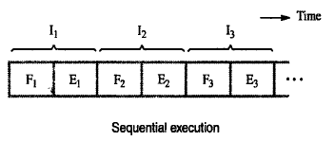
Basic idea of Instruction Pipelining
Sequential Execution of a program
The processor executes a program by fetching(Fi) and executing(Ei) instructions one by one.
‹#›

Slide 84
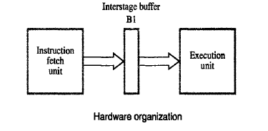
Hardware organization and instruction pipeline
Consists of 2 hardware units one for fetching and another one for execution as follows.
Also has intermediate buffer to store the fetched instruction
‹#›

Slide 85
2 stage pipeline
Execution of instruction in pipeline manner is controlled by a clock.
In the first clock cycle, fetch unit fetches the instruction I1 and store it in buffer B1.
In the second clock cycle, fetch unit fetches the instruction I2 , and execution unit executes the instruction I1 which is available in buffer B1.
By the end of the second clock cycle, execution of I1 gets completed and the instruction I2 is available in buffer B1.
In the third clock cycle, fetch unit fetches the instruction I3 , and execution unit executes the instruction I2 which is available in buffer B1.
In this way both fetch and execute units are kept busy always.
‹#›

Slide 86
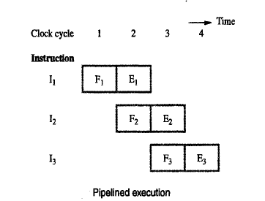
Contd…
‹#›

Slide 87
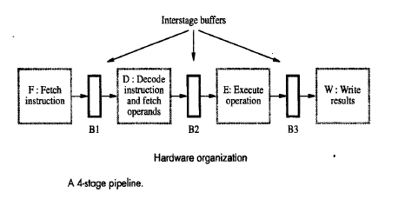
Hardware organization for 4 stage pipeline
Pipelined processor may process each instruction in 4 steps.
Fetch(F): Fetch the Instruction
Decode(D): Decode the Instruction
Execute (E) : Execute the Instruction
Write (W) : Write the result in the destination location
4 distinct hardware units are needed as shown below.
‹#›

Slide 88
Execution of instruction in 4 stage pipeline
In the first clock cycle, fetch unit fetches the instruction I1 and store it in buffer B1.
In the second clock cycle, fetch unit fetches the instruction I2 , and decode unit decodes instruction I1 which is available in buffer B1.
In the third clock cycle fetch unit fetches the instruction I3 , and decode unit decodes instruction I2 which is available in buffer B1 and execution unit executes the instruction I1 which is available in buffer B2.
In the fourth clock cycle fetch unit fetches the instruction I4 , and decode unit decodes instruction I3 which is available in buffer B1, execution unit executes the instruction I2 which is available in buffer B2 and write unit write the result of I1.
‹#›

Slide 89
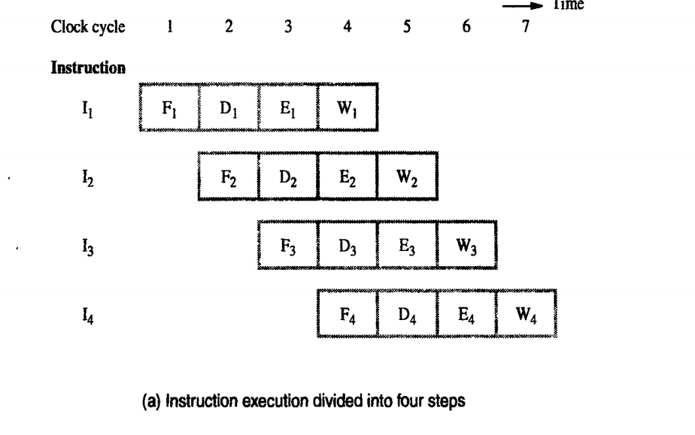
‹#›

Slide 90
Contd…
‹#›

Slide 91
Role of cache memory in Pipelining
Each stage of the pipeline is controlled by a clock cycle whose period is that the fetch, decode, execute and write steps of any instruction can each be completed in one clock cycle.
However the access time of the main memory may be much greater than the time required to perform basic pipeline stage operations inside the processor.
The use of cache memories solve this issue.
If cache is included on the same chip as the processor, access time to cache is equal to the time required to perform basic pipeline stage operations .
‹#›

Slide 92
Pipeline Performance
Pipelining increases the CPU instruction throughput - the number of instructions completed per unit time.
The increase in instruction throughput means that a program runs faster and has lower total execution time.
Example in 4 stage pipeline, the rate of instruction processing is 4 times that of sequential processing.
Increase in performance is proportional to no. of stages used.
However, this increase in performance is achieved only if the pipelined operation is continued without any interruption.
But this is not the case always.
‹#›

Slide 93
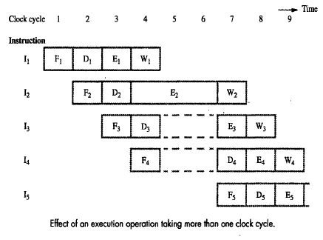
Contd…
Consider the scenario, where one of the pipeline stage may require more clock cycle than the other.
For example, consider the following figure where instruction I2 takes 3 cycles to completes its execution(cycle 4,5,6)
In cycle 5,6 the write stage must be told to do nothing, because it has no data to work with.
‹#›

Slide 94
The Major Hurdle of Pipelining—Pipeline Hazards
These situations are called hazards, that prevent the next instruction in the instruction stream from executing during its designated clock cycle.
Hazards reduce the performance from the ideal speedup gained by pipelining.
prepared by Geetha.G and Safa.M

Slide 95
There are three classes of hazards:
1. Structural hazards
arise from resource conflicts when the hardware cannot support all possible combinations of instructions simultaneously in overlapped execution.
prepared by Geetha.G and Safa.M

Slide 96
2. Data hazards
arise when an instruction depends on the results of a previous instruction
3.Control/Instruction hazards
The pipeline may be stalled due to unavailability of the instructions due to cache miss and instruction need to be fetched from main memory.
arise from the pipelining of branches and other instructions that change the PC.
Hazards in pipelines can make it necessary to stall the pipeline
prepared by Geetha.G and Safa.M

Slide 97
Structural Hazards
If some combination of instructions cannot be accommodated because of resource conflicts, the processor is said to have a structural hazard.
When a sequence of instructions encounters this hazard, the pipeline will stall one of the instructions until the required unit is available. Such stalls will increase the CPI from its usual ideal value of 1.
prepared by Geetha.G and Safa.M

Slide 98
Structural Hazards
Some pipelined processors have shared a single-memory pipeline for data and instructions. As a result, when an instruction contains a data memory reference, it will conflict with the instruction reference for a later instruction
To resolve this hazard, we stall the pipeline for 1 clock cycle when the data memory access occurs. A stall is commonly called a pipeline bubble or just bubble
prepared by Geetha.G and Safa.M

Slide 99
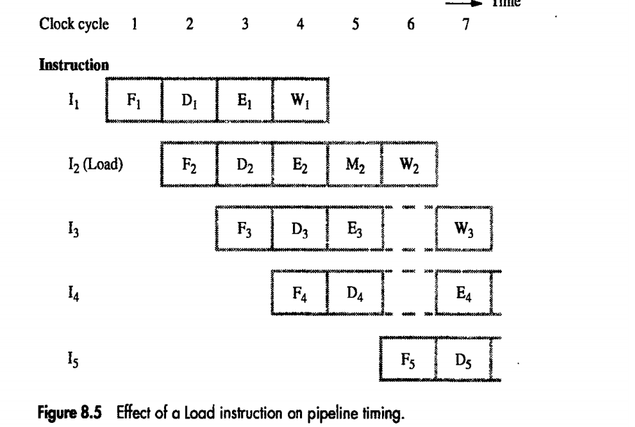
Load x(r1),r2
prepared by Geetha.G and Safa.M

Slide 100
Data Hazards
Data hazards arise when an instruction depends on the results of a previous instruction in a way that is exposed by the overlapping of instructions in the pipeline.
Consider the pipelined execution of these instructions:
ADD R2,R3,R1
SUB R4,R1,R5
prepared by Geetha.G and Safa.M

Slide 101
the DADD instruction writes the value of R1 in the WB pipe stage, but the DSUB instruction reads the value during its ID stage. This problem is called a data hazard
prepared by Geetha.G and Safa.M

Slide 102
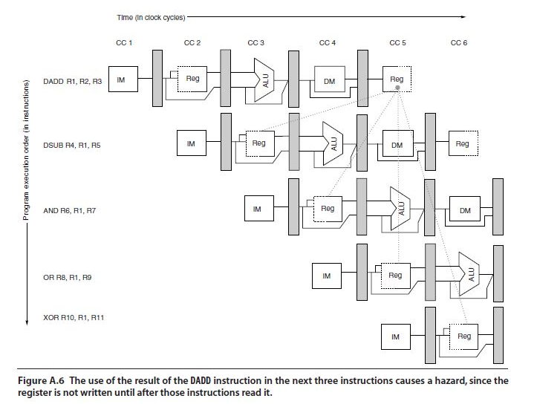
prepared by Geetha.G and Safa.M

Slide 103
Minimizing Data Hazard Stalls by Forwarding
forwarding (also called bypassing and sometimes short-circuiting
prepared by Geetha.G and Safa.M

Slide 104
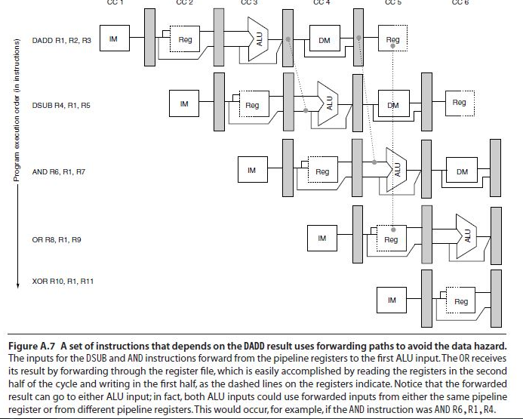
prepared by Geetha.G and Safa.M

Slide 105
Data Hazards Requiring Stalls
Consider the following sequence of instructions:
LD 0(R2),R1
DSUB R4,R1,R5
AND R6,R1,R7
OR R8,R1,R9
prepared by Geetha.G and Safa.M

Slide 106
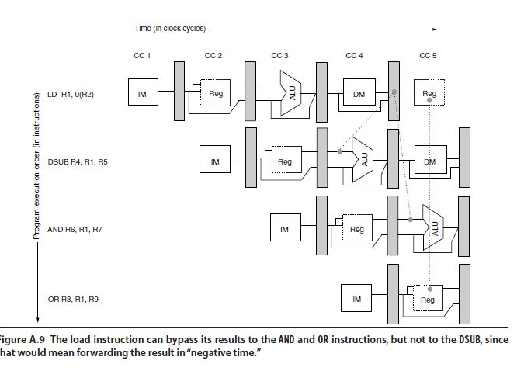
prepared by Geetha.G and Safa.M

Slide 107
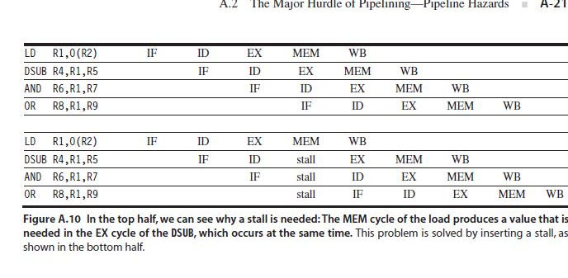
prepared by Geetha.G and Safa.M

Slide 108
Instruction Hazards
Whenever the stream of instructions supplied by the instruction fetch unit is interrupted, the pipeline stalls.
‹#›

Slide 109
Unconditional Branches
If Sequence of instruction being executed in two stages pipeline instruction I1 to I3 are stored at consecutive memory address and instruction I2 is a branch instruction.
If the branch is taken then the PC value is not known till the end of I2.
Next third instructions are fetched even though they are not required
Hence they have to be flushed after branch is taken and new set of instruction have to be fetched from the branch address
‹#›

Slide 110
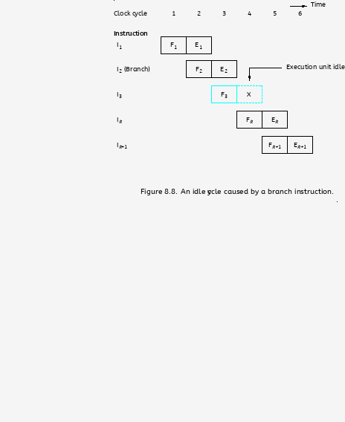
Unconditional Branches
‹#›

Slide 111
Branch Timing
Branch penalty
The time lost as the result of branch instruction
Reducing the penalty
The branch penalties can be reduced by proper
scheduling using compiler techniques
For longer pipeline, the branch penalty may be much higher
Reducing the branch penalty requires branch target address to be computed earlier in the pipeline
Instruction fetch unit must have dedicated hardware to identify a branch instruction and compute branch target address as quickly as possible after an instruction is fetched
‹#›

Slide 112
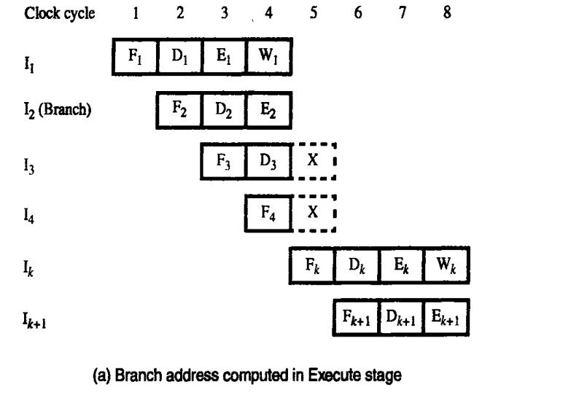
Branch Timing
‹#›

Slide 113
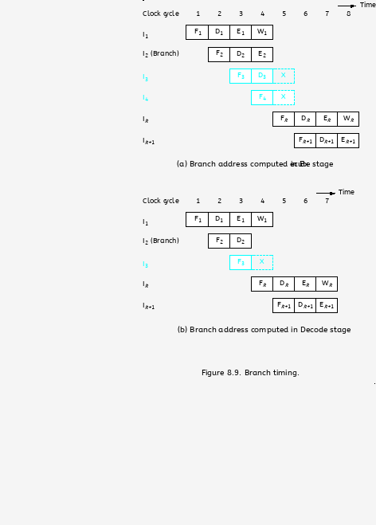
Branch Timing
‹#›

Slide 114
Instruction Queue and Prefetching
Either a cache miss or a branch instruction may stall the pipeline for one or more clock cycle.
To reduce the interruption many processor uses the instruction fetch unit which fetches instruction and put them in a queue before it is needed.
Dispatch unit-Takes instruction from the front of the queue and sends them to the execution unit, it also perform the decoding operation
Fetch unit keeps the instruction queue filled at all times.
If there is delay in fetching the instruction, the dispatch unit continues to issue the instruction from the instruction queue
‹#›

Slide 115
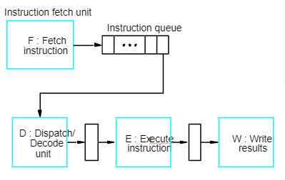
Instruction Queue and Prefetching
‹#›
Notes:
‹#›

Slide 116
Conditional Branches
A conditional branch instruction introduces the added hazard caused by the dependency of the branch condition on the result of a preceding instruction.
The decision to branch cannot be made until the execution of that instruction has been completed.
‹#›

Slide 117
Delayed Branch
The location following the branch instruction is branch delay slot.
The delayed branch technique can minimize the penalty arise due to conditional branch instruction
The instructions in the delay slots are always fetched. Therefore, we would like to arrange for them to be fully executed whether or not the branch is taken.
The objective is to place useful instructions in these slots.
The effectiveness of the delayed branch approach depends on how often it is possible to reorder instructions.
‹#›

Slide 118
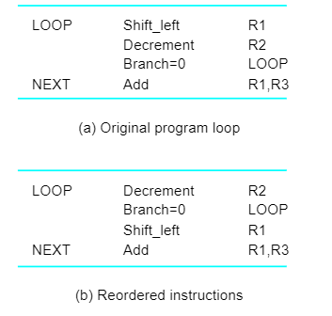
Delayed Branch
‹#›
Notes:
‹#›

Slide 119
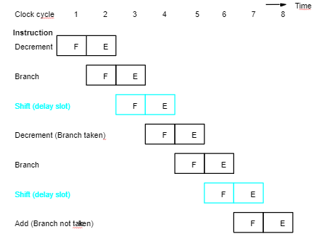
Delayed Branch
‹#›
Notes:
‹#›

Slide 120
Branch Prediction
To predict whether or not a particular branch will be taken.
Simplest form: assume branch will not take place and continue to fetch instructions in sequential address order.
Until the branch is evaluated, instruction execution along the predicted path must be done on a speculative basis.
Speculative execution: instructions are executed before the processor is certain that they are in the correct execution sequence.
Need to be careful so that no processor registers or memory locations are updated until it is confirmed that these instructions should indeed be executed.
‹#›

Slide 121
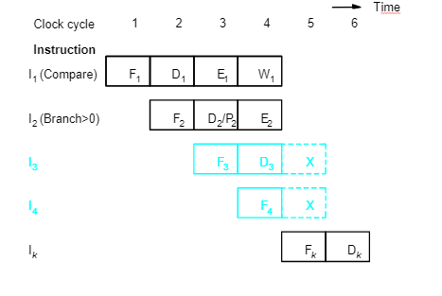
Incorrectly Predicted Branch
‹#›
Notes:
‹#›

Slide 122
Branch Prediction
Better performance can be achieved if we arrange for some branch instructions to be predicted as taken and others as not taken.
Use hardware to observe whether the target address is lower or higher than that of the branch instruction.
Let compiler include a branch prediction bit as 0 or 1. The fetch unit checks this bit to predict whether the branch is taken or not taken branch
So far the branch prediction decision is always the same every time a given instruction is executed – static branch prediction.
‹#›

Slide 123
Branch Prediction
Static Prediction
Dynamic branch Prediction
‹#›

Slide 124
Static Prediction
Prediction is carried out by compiler and it is static because the prediction is already known before the program is executed
‹#›

Slide 125
Dynamic Branch Prediction
Dynamic prediction in which the prediction decision may change depending on the execution history
‹#›

Slide 126
Branch Prediction Algorithm
If the branch taken recently,the next time if the same branch is executed,it is likely that the branch is taken
State 1: LT : Branch is likely to be taken
State 2: LNT : Branch is likely not to be taken
1.If the branch is taken,the machine moves to LT. otherwise it remains in state LNT.
2.The branch is predicted as taken if the corresponding state machine is in state LT, otherwise it is predicted as not taken
‹#›

Slide 127
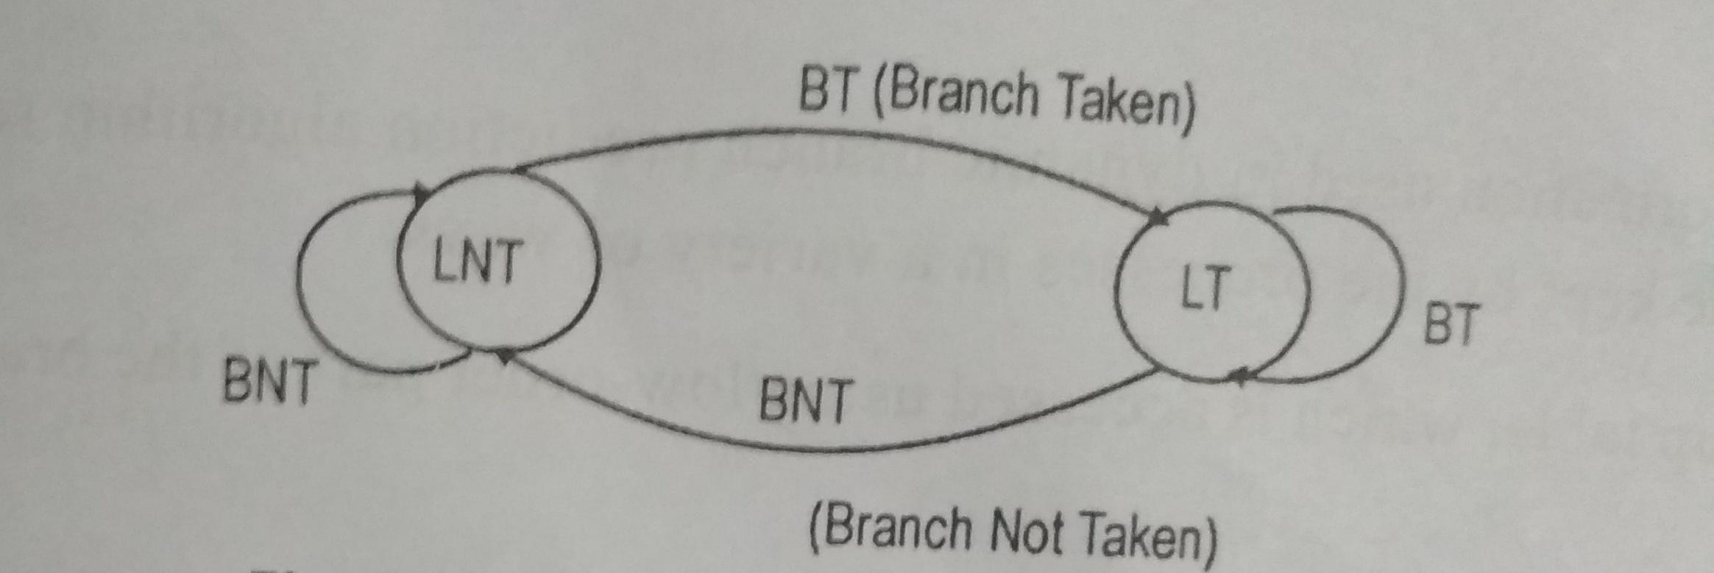
Branch Prediction Algorithm
‹#›

Slide 128
4 State Algorithm
ST-Strongly likely to be taken
LT-Likely to be taken
LNT-Likely not to be taken
SNT-Strongly not to be taken
Step 1: Assume that the algorithm is initially set to LNT
Step 2: If the branch is actually taken changes to ST, otherwise it is changed to SNT.
Step 3: when the branch instruction is encountered, the branch will taken if the state is either LT or ST and begins to fetch instruction at branch target address, otherwise it continues to fetch the instruction in sequential manner
‹#›

Slide 129
4 State Algorithm
When in state SNT,the instruction fetch unit predicts that the branch will not be taken
If the branch is actually taken,that is if the prediction is incorrect,the state changes to LNT
‹#›

Slide 130
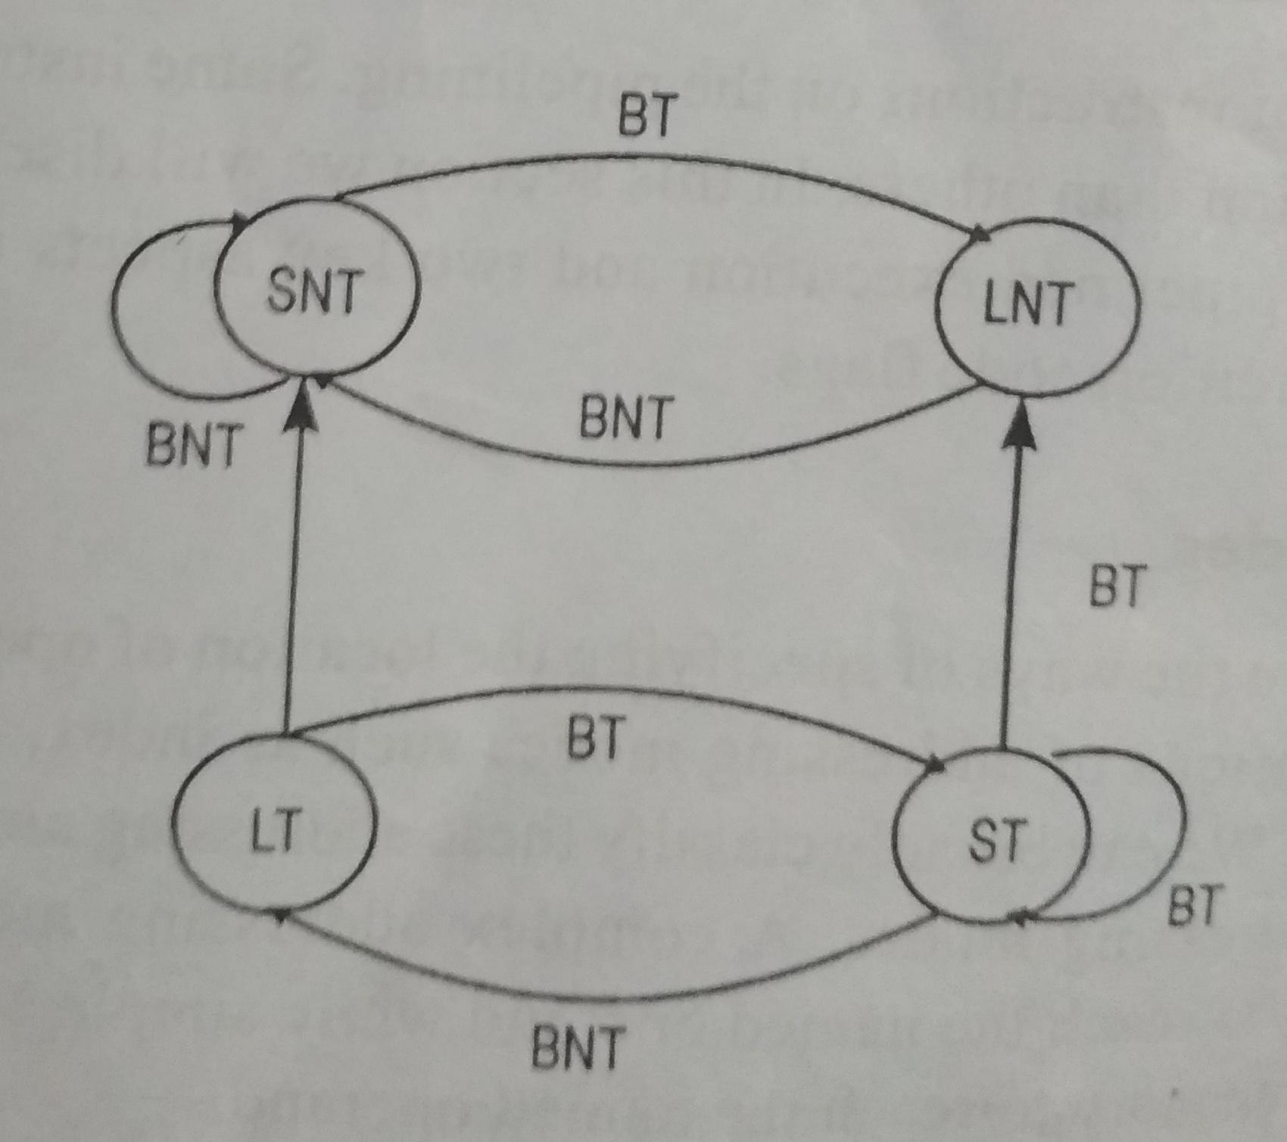
4 State Algorithm
‹#›

Slide 131
INFLUENCE ON INSTRUCTION SETS
‹#›

Slide 132
OVERVIEW
Some instructions are much better suited to pipeline
execution than others.
Addressing modes
Conditional code flags
‹#›

Slide 133
ADDRESSING MODES
Addressing modes include simple ones and complex
ones.
In choosing the addressing modes to be implemented in
a pipelined processor, we must consider the effect of
each addressing mode on instruction flow in the
pipeline:
- Side effects
- The extent to which complex addressing modes cause the pipeline to stall
- Whether a given mode is likely to be used by compilers
‹#›

Slide 134
RECALL
Load X(R1), R2
Load (R1), R2
‹#›

Slide 135
COMPLEX ADDRESSING MODE
Load (X(R1)), R2
Clock cycle
T
ime
1
2
3
4
5
6
7
Load
F
D
X
+
[R1]
[X
+
[R1]]
[[X
+
[R1]]]
W
F
orw
ard
Ne
xt instruction
F
D
E
W
(a) Complex addressing mode
‹#›

Slide 136
SIMPLE ADDRESSING MODE
Add #X, R1, R2
Load (R2), R2
Load (R2), R2
Add
F
D
X
+
[R1]
W
Load
F
D
[X
+
[R1]]
W
Load
F
D
[[X
+
[R1]]]
W
Ne
xt instruction
F
D
E
W
(b) Simple addressing mode
‹#›

Slide 137
ADDRESSING MODES
In a pipelined processor, complex addressing modes do
not necessarily lead to faster execution.
Advantage: reducing the number of instructions /
program space
Disadvantage: cause pipeline to stall / more hardware
to decode / not convenient for compiler to work with
Conclusion: complex addressing modes are not suitable
for pipelined execution.
‹#›

Slide 138
ADDRESSING MODES
Good addressing modes should have:
- Access to an operand does not require more than one access to the memory
- Only load and store instruction access memory operands
- The addressing modes used do not have side effects
Register, register indirect, index
‹#›

Slide 139
CONDITIONAL CODES
If an optimizing compiler attempts to reorder instruction
to avoid stalling the pipeline when branches or data
dependencies between successive instructions occur, it
must ensure that reordering does not cause a change in
the outcome of a computation.
The dependency introduced by the condition-code flags
reduces the flexibility available for the compiler to
reorder instructions.
‹#›

Slide 140
CONDITIONAL CODES
Add
Compare
Branch=0
R1,R2
R3,R4
. . .
a) A program fragment
Compare
Add
Branch=0
R3,R4
R1,R2
. . .
b) Instructions reordered
Instruction reordering
‹#›

Slide 141
CONDITIONAL CODES
Two conclusion:
To provide flexibility in reordering instructions, the
condition-code flags should be affected by as few
instruction as possible.
The compiler should be able to specify in which
instructions of a program the condition codes are
affected and in which they are not.
‹#›

